Slide 1

Posit Multiplier Using DML Logic
Dan Shaul, 213744287
Guy Gonen, 305698599

Slide 2

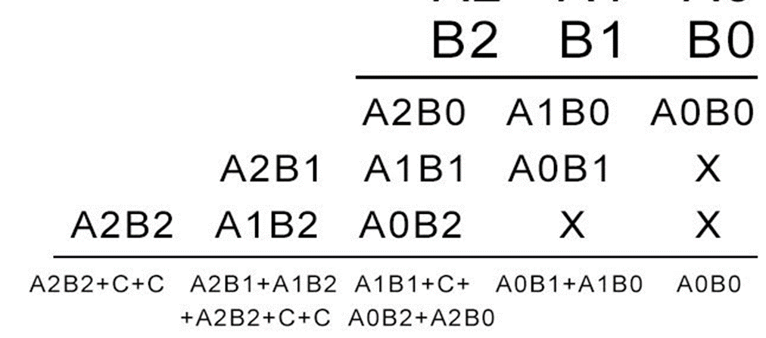
Binary Multiplication
One of the biggest and slowest circuits in arithmetic and logic units is the multiplier.
First of all, we will represent the basic format of multiplication of two binary numbers, and we will describe how to build the architecture of it.
A multiplication of binary numbers is exactly like a multiplication we have learned in primary school: let's say we have two binary numbers, each of 3 bits. In this case we will take each bit of the multiplier (operand B in the FIG1 below) and multiply it with each digit of the multiplicand (operand A) dealing with any carries into the next column as we process the multiplicand right-to-left. The output from this step is called a partial product. And we will repeat this step for the remaining bits of the multiplier. Each partial product is shifting one bit for the left, reflecting the increasing weight of the multiplier bits. The partial product is N bit wide since there are no carries and if the multiplier is M bits wide there will be M partial products, when we add the partial products together, we will get N+M bit result if we account for the possible carry-out from the high order bit.

Slide 3
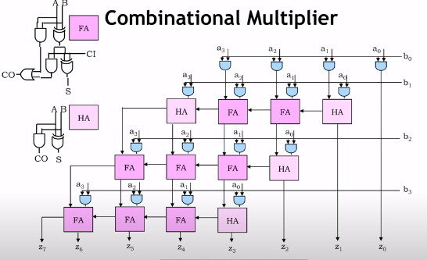
The Basic Architecture
In order to form each partial product we use 2-input AND gates, and for adding the partial products we use Half-Adders when we have only two input bits and Full-Adders when we get 3 input bits.

Slide 4
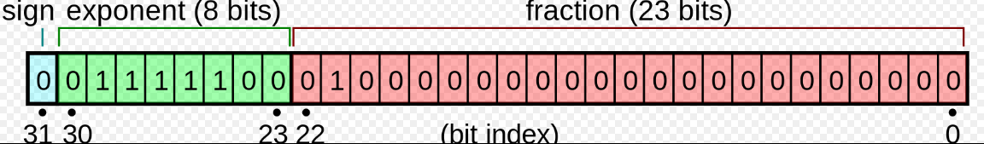

Floating Numbers
In our days the most common representation of numbers in the computer world is the floating-point format. In this format each number has 3 parts:1-bit for the sign which is the MSB of the number, n bits for the exponent, and (N-n-1) bits for the mantissa. The number n is defined by the precision of the format, for example “single-precision” is using 32 bits for each number and has 8 bits for the exponent. In order to get the true value of the exponent we need to subtract a bias number for the value we get. So if we stick with our example of 32 bits the bias we need to subtract is 127, because the range of the exponent is [-126,127]. We have two special exponent values, one where all bits are zeros which is for zero, and the other is where all bits are ones which is for infinity. We also need to take into account that we have an implicit 1 that we add to the mantissa in order to be more accurate.
The general form of floating-point number is: $x={(−1)}^{sign}∙2^{exp−bias}∙\left(1.mantissa\right)$

Slide 5
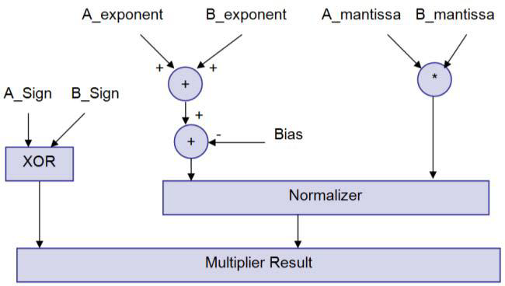

Floating Numbers Multiplier
So how do we combine the two topics we were discussing until now? Meaning, how do we multiply floating-point numbers?
First, the mantissas are multiplied together with an unsigned integer multiplier, like the one from fig 2. Then, the exponents are added, and the excess value (exponent_offset)$∙2^{k−1}$ where k is the number operands, is subtracted from the result. The sign of the output is the XOR of the signs of the inputs (sign A and sign B). After multiplication has taken place, the normalizer normalizes the result, if necessary, by adjusting the mantissa and exponent of the result to ensure that the MSB of the mantissa is 1.

Slide 6
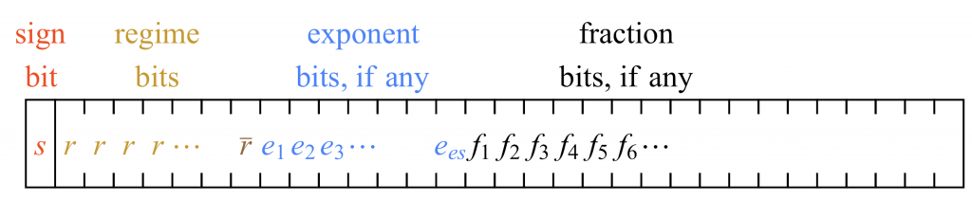
Posit Format
A generic posit format consists of a mandatory sign, one or multiple regime bits, multiple optional exponent bits, and multiple optional fraction bits . The sign bit is 0 for positive numbers and 1 for negative ones. The number of regime bits is dynamic following a special encoding. After the sign bit, the regime includes a run of 0 or 1, which is terminated by an opposite bit (r̄) or at the end of the number format. Similarly, the number of bits for the exponent and fraction is dynamic. A posit number includes the exponent and fraction only if necessary.

Slide 7
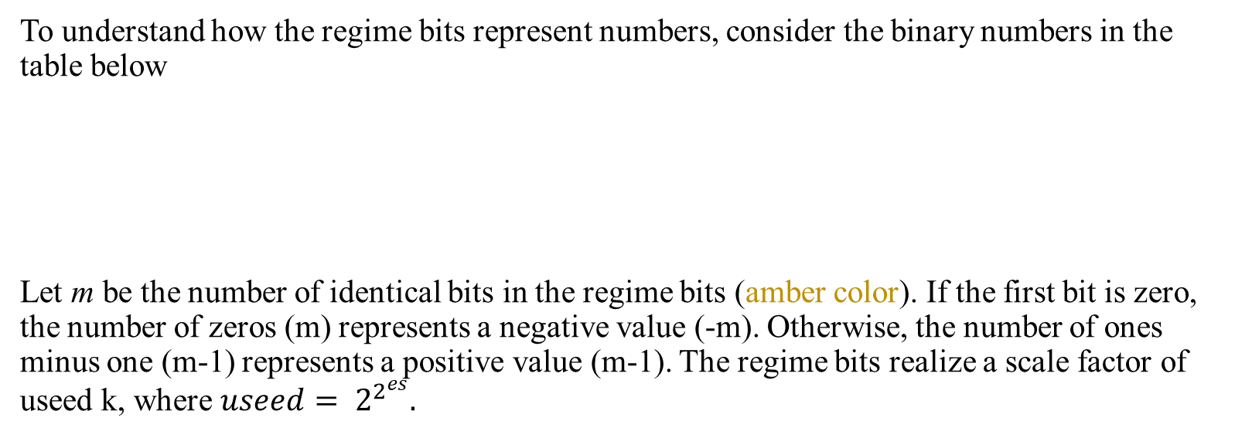
Posit Format
To understand how the regime bits represent numbers, consider the binary numbers in the table below
Let m be the number of identical bits in the regime bits (amber color). If the first bit is zero, the number of zeros (m) represents a negative value (-m). Otherwise, the number of ones minus one (m-1) represents a positive value (m-1). The regime bits realize a scale factor of useed k, where $useed= 2^{2^{es}}.$

Slide 8
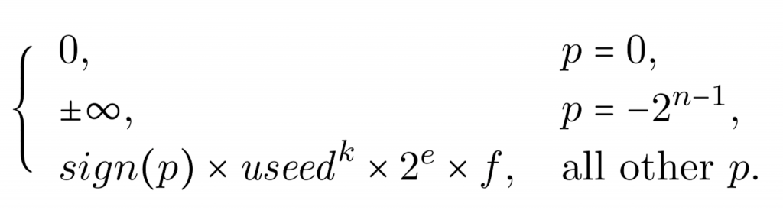

Posit Format
Exponent e (blue bits) is regarded as an unsigned integer to realize another scale $2^{e}$. Unlike IEEE 754, posit does not use bias for the exponent. Each exponent may be up to a predefined number of bits (es). The remaining bits after the regime and the exponent are used for the fraction (f). Similar to IEEE 754, the fraction includes a hidden bit, which is always 1 as posit does not have any denormal number. Overall, an n-bit posit number (p) can represent the following numbers.

Slide 9
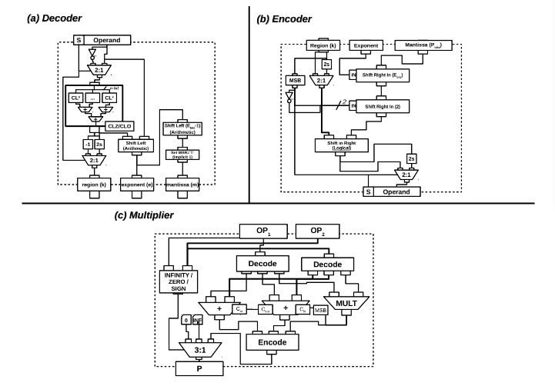
The Posit Multiplier
The Posit Multiplier algorithm goes like this:
We divide the number represented in post floating point to 4 parts , the mantissa, exponent, reg ,and 1 bit for sign
We multiply the mantissas a regular multiplication
We take the bit in the place n + m (assuming mantissa sized are n and m), then we insert it as a carry into the exponent Adder
We take the carryout of the exponent Adder, and we insert it to the regs adder
In the end we take all the parts we got, and we insert it to the encoder that takes the parts and forms the posit number

Slide 10
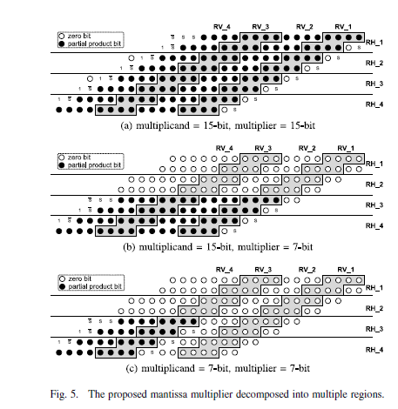
The Posit Multiplier
In our project we would focus on the mantissa multiplier, and we would want to make it more efficient, so let's take an example of implemantion of mantissa multiplier:
For Posit(16, 1) multiplier, a 15-bit mantissa multiplier is used. When using radix-4 Booth multiplication algorithm ,the partial product array is shown in Fig. 5(a). There is a total of 8 partial products and each partial product is 16-bit.In the proposed design, the 15-bit multiplier is divided into 4groups: the most significant 3-bit is one group, and the remain-ing 12-bit are divided into three 4-bit groups. Correspondingly,the 8 partial products are divided into 4 groups,RH_1,RH_2,RH_3, and RH_4, as shown in Fig. 5. If the multiplier is less than 3-bit, then only the two partial products in RH_4 a regenerated while all others are set to zeros. If the multiplier is more than 3-bit but less than 7-bit, then partial products in RH_3 and RH_4 are generated. If the multiplier is more
than 7-bit but less than 11-bit, then partial products in RH_2,RH_3, and RH_4 are generated. Finally, if the multiplier is more than 11-bit, then all the partial products are generated.Similarly, the 15-bit multiplicand is also divided into 4 groups. Each partial product is correspondingly divided into4 groups,RV_1,RV_2,RV_3, and RV_4, as shown in Fig. 5.If the multiplicand is less than 3-bit, then only RV_4 is generated while all others are set to zeros. If the multiplicand is more than 3-bit but less than 7-bit, the RV_3 and RV_4 a regenerated. If the multiplicand is more than 7-bit but less than11-bit, then RV_2,RV_3, and RV_4 are generated. Finally, if the multiplicand is more than 11-bit, then all bits in the partial product are generated.

Slide 11

So, what is the difference between the two multipliers?
As we mentioned before, the multiplier is one of the most critical units that influences the power and speed of our system.
Unlike the conventional floating-point format, the bit-width of each component in posit format is dynamic (except the 1-bit sign). The sign and the regime are always appeared in the format. The exponent and the mantissa are only included when the sign and the regime do not occupy all the bit positions. Therefore, the mantissa (including the implicit bit) bit-width can be from 1-bit to (nb−es)-bit, where nb is the total bit-width of posit format and es is the exponent bit-width. As the actual mantissa bit-width is not always the maximum value, the mantissa does not always require a (nb−es)-bit multiplier, such as we saw in the floating-point multiplier. When using (nb−es)-bit multiplier for small bit-width mantissa, power or energy is wasted.
With the same bit-width, the IEEE standard multiplier can achieve better timing, area, and power. This is because the IEEE 754-2008 floating-point format has constant bit-width for each component and thus the component extraction and packing module used in posit design can be eliminated. However, posit has much larger dynamic range than IEEE floating-point format. Therefore, in practical applications, small posit format can already meet the numeric requirement of the application. Moreover, the non-uniformed distribution is closer to the data distribution in some applications. As a result, the posit format is used more efficiently in some applications. For deep learning, 8-bit posit can achieve the performance of 32-bit IEEE floating-point with much better hardware efficiency

Slide 12
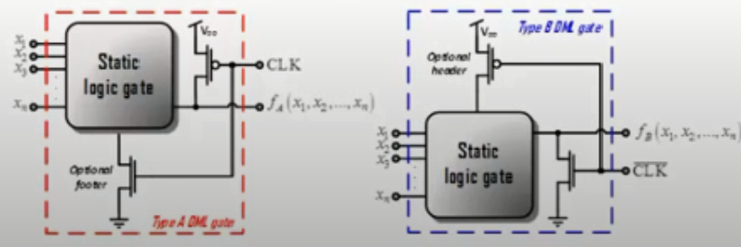
Dual Mode Logic
Dual Mode Logic is the combination of two different logic families: the CMOS family and the dynamic family. It has two operation modes: static and dynamic. That way we enjoy the benefits of each family. In we are very efficient in terms of energy, and in the dynamic mode we are have very high performance. We also have the ability to do on-the-fly switches between the two modes according to computational needs

Slide 13

Our Goal:
In our project we would like to actualize the mantissa multiplier using DML logic that saves energy and reduces calculation time
We will do it in steps:
First, we prepare the mantissa multiplier circuit using simple CMOS logic then we would track the critical path , which is the time that takes the most energy and time for calculation , then we actualize this path using DML logic instead of CMOS , thus making our system much faster and energy efficient

